Slide 2
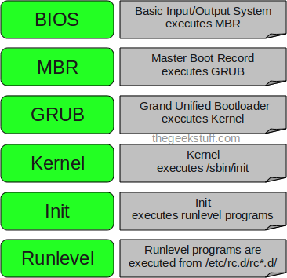
Linux BOOT process

Slide 3
1. BIOS
BIOS stands for Basic Input/Output System
Performs some system integrity checks
Searches, loads, and executes the boot loader program.
It looks for boot loader in floppy, cd-rom, or hard drive. You can press a key (typically F12 of F2, but it depends on your system) during the BIOS startup to change the boot sequence.
Once the boot loader program is detected and loaded into the memory, BIOS gives the control to it.
So, in simple terms BIOS loads and executes the MBR boot loader.

Slide 4
2. MBR
MBR stands for Master Boot Record.
It is located in the 1st sector of the bootable disk. Typically /dev/hda, or /dev/sda
MBR is less than 512 bytes in size. This has three components 1) primary boot loader info in 1st 446 bytes 2) partition table info in next 64 bytes 3) mbr validation check in last 2 bytes.
It contains information about GRUB (or LILO in old systems).
So, in simple terms MBR loads and executes the GRUB boot loader.

Slide 5
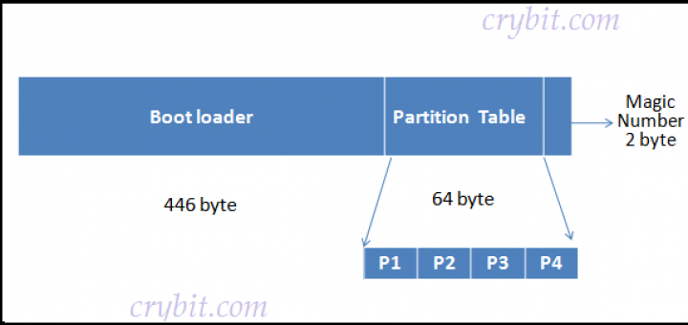

Slide 6
3. GRUB
GRUB stands for Grand Unified Bootloader.
If you have multiple kernel images installed on your system, you can choose which one to be executed.
GRUB displays a splash screen, waits for few seconds, if you don’t enter anything, it loads the default kernel image as specified in the grub configuration file.
GRUB has the knowledge of the filesystem (the older Linux loader LILO didn’t understand filesystem).
Grub configuration file is /boot/grub/grub.conf (/etc/grub.conf is a link to this). The following is sample grub.conf of CentOS.

Slide 7
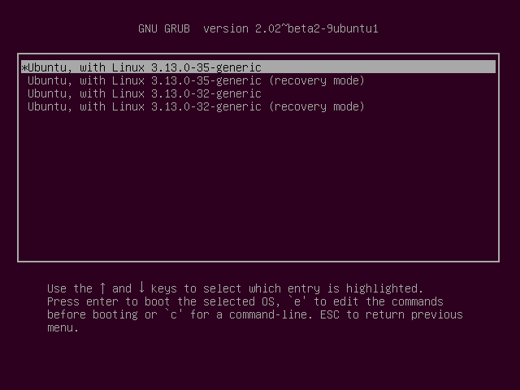

Slide 8
3.GRUB cont.
#boot=/dev/sda
default=0
timeout=5
splashimage=(hd0,0)/boot/grub/splash.xpm.gz
hiddenmenu
title CentOS (2.6.18-194.el5PAE)
root (hd0,0)
kernel /boot/vmlinuz-2.6.18-194.el5PAE ro root=LABEL=/
initrd /boot/initrd-2.6.18-194.el5PAE.img
As you notice from the above info, it contains kernel and initrd image.
So, in simple terms GRUB just loads and executes Kernel and initrd images

Slide 9
4. KERNEL
Mounts the root file system as specified in the “root=” in grub.conf
Kernel executes the /sbin/init program
Since init was the 1st program to be executed by Linux Kernel, it has the process id (PID) of 1. Do a ‘ps -ef | grep init’ and check the pid.
initrd stands for Initial RAM Disk.
initrd is used by kernel as temporary root file system until kernel is booted and the real root file system is mounted. It also contains necessary drivers compiled inside, which helps it to access the hard drive partitions, and other hardware.

Slide 10
5. INIT
Looks at the /etc/inittab file to decide the Linux run level.
Following are the available run levels
  0 – halt
  1 – Single user mode
  2 – Multiuser, without NFS
  3 – Full multiuser mode
  4 – unused
  5 – X11
  6 – reboot
Init identifies the default initlevel from /etc/inittab and uses that to load all appropriate program.
Execute ‘grep initdefault /etc/inittab’ on your system to identify the default run level
If you want to get into trouble, you can set the default run level to 0 or 6. Since you know what 0 and 6 means, probably you might not do that.
Typically you would set the default run level to either 3 or 5.

Slide 11
6. RUN LEVEL PROGRAMS
When the Linux system is booting up, you might see various services getting started. For example, it might say “starting sendmail …. OK”. Those are the runlevel programs, executed from the run level directory as defined by your run level.
Depending on your default init level setting, the system will execute the programs from one of the following directories.
  Run level 0 – /etc/rc.d/rc0.d/
  Run level 1 – /etc/rc.d/rc1.d/
  Run level 2 – /etc/rc.d/rc2.d/
  Run level 3 – /etc/rc.d/rc3.d/
  Run level 4 – /etc/rc.d/rc4.d/
  Run level 5 – /etc/rc.d/rc5.d/
  Run level 6 – /etc/rc.d/rc6.d/

Slide 12
RUN LEVEL PROGRAMS cont.
Please note that there are also symbolic links available for these directory under /etc directly. So, /etc/rc0.d is linked to /etc/rc.d/rc0.d.
Under the /etc/rc.d/rc*.d/ directories, you would see programs that start with S and K.
Programs starts with S are used during startup. S for startup.
Programs starts with K are used during shutdown. K for kill.
There are numbers right next to S and K in the program names. Those are the sequence number in which the programs should be started or killed.
For example, S12syslog is to start the syslog deamon, which has the sequence number of 12. S80sendmail is to start the sendmail daemon, which has the sequence number of 80. So, syslog program will be started before sendmail.

Slide 13
Linux filesystem
Directory | Description
/ (root filesystem) | The root filesystem is the top-level directory of the filesystem. It must contain all of the files required to boot the Linux system before other filesystems are mounted. It must include all of the required executables and libraries required to boot the remaining filesystems. After the system is booted, all other filesystems are mounted on standard, well-defined mount points as subdirectories of the root filesystem.
/bin | The /bin directory contains user executable files.
/boot | Contains the static bootloader and kernel executable and configuration files required to boot a Linux computer.

Slide 14
Linux file system Cont.
/dev | This directory contains the device files for every hardware device attached to the system. These are not device drivers, rather they are files that represent each device on the computer and facilitate access to those devices.
/etc | Contains the local system configuration files for the host computer.
/home | Home directory storage for user files. Each user has a subdirectory in /home.
/lib | Contains shared library files that are required to boot the system.
/media | A place to mount external removable media devices such as USB thumb drives that may be connected to the host.

Slide 15
Linux file system Cont.
/mnt | A temporary mountpoint for regular filesystems (as in not removable media) that can be used while the administrator is repairing or working on a filesystem.
/opt | Optional files such as vendor supplied application programs should be located here.
/root | This is not the root (/) filesystem. It is the home directory for the root user.
/sbin | System binary files. These are executables used for system administration.

Slide 16
Linux file system Cont.
/tmp | Temporary directory. Used by the operating system and many programs to store temporary files. Users may also store files here temporarily. Note that files stored here may be deleted at any time without prior notice.
/usr | These are shareable, read-only files, including executable binaries and libraries, man files, and other types of documentation.
/var | Variable data files are stored here. This can include things like log files, MySQL, and other database files, web server data files, email inboxes, and much more.

Slide 17
Create a file:
$ touch myfile.txt
$ cat myfile
Write to file:
$ cat myfile1 myfile2 myfile3 > myfile.txt
Append to file :
$ echo “hi there” >> myfile.txt

Slide 18
$ cat myfile.txt | more
$ cat myfile.txt | less
$ echo “my shopping list ” | cat -mylist.txt
$ cat –s myfile # omits blank lines
$ cat –n myfiles # shows line numbers

Slide 19
tac
Using tac without a filename will cause it to operate on the input from the keyboard. Hitting Ctrl+D will stop the input phase, and tac will list in reverse order whatever you’d typed in.
We use tac to list the syslog file in reverse, and pipe it into head. By telling head to only print the first line it receives (which thanks to tac is the last line in the file), we see the latest entry in the syslog file.
tac /var/log/syslog | head -1

Slide 20
cp — Copy files and directories.
rm — Remove file
mkdir – make directory
rmdir – remove directory
less — Scrolling text viewer.
more — Display text one screen at a time.
tee — Route a file's contents to multiple outputs.
touch — Update the timestamp of a file or directory.

Slide 21
List:
Ls –a
Ls –l
La –al

Slide 22
Emptying a file
writing /dev/null :
$ cat /dev/null > myfile.txt
null to file:
$ > myfile.txt
true to file:
$ true > myfile.txt or
$ : > myfile.txt
echo null :
$ echo “” > myfile.txt
Does it work?
Try :
$ echo –n > myfile.txt

Slide 23
Emptying a file Cont.
Using data duplicator
$ dd if = /dev/null of= /myfile.txt
Using truncate:
$ truncate -s 0 > myfile

Slide 24
Substitution operators
${VAR:-word}
${VAR:=word}
${VAR:? message}
${VAR:offset:length}

Slide 25
Regular expressions
Regular expressions are search patterns that can be used by some utilities like grep, awk, sed, …
Regular expressions are not same as shell wildcards.
When using regular expressions put them between strong quotes.
Some of regular expressions are:
^text : the line starts with text
Text$ : the line ends with text
. : wildcard matches with any single character
\{2\} : matches exactly 2 of previous characters
\{1,3\} : matches minimum 1 and maximum 3 of previous character

Slide 26
Regular expression Cont.
* : Matches 0 to an infinite number of previous characters
[abc] , [a-c] : matches a,b or c.
colou?r : matches 0 or 1 of the previous character

Slide 27
Pattern matching
Pattern matching is used to remove a pattern from a variable.
${VAR#pattern}
FILENAME=/usr/bin/blah
echo ${FILENAME#*/} → usr/bin/blah
${VAR##pattern}
echo ${FILENAME##*/} → blah
${VAR%pattern}
echo ${FILENAME%/*} → /usr/bin
${VAR%%pattern}
echo ${FILENAME%%/*} →

Slide 28
Calculations
$((4+5))
$((7/3))
“scale=9; 7/3”|bc
“7+5”|bc

Slide 29
Calculations
# DATE= $( date +%d-%m-%y)
# echo the day is ${DATE%%-*}
MONTH=${DATE%-*}
echo month is ${MONTH#*-}
Echo year is ${YEAR##*1}

Slide 30
String Verification
Use test –z to check if a string is empty:
test –z $1 or [-z $1] or [[ -z $1 ]]
test –z $1 && exit 1
[$BLAH=a*] || echo string does not start with a
[[$BLAH=a*]] || echo string does not start with a
Use [[…]] to check for specific patterns
[[$1==‘[a-z]*’ ]]

Slide 31
String replacement
$ first="I love Suzy and Mary"
$ second="Sara"
$ first=${first/Suzy/$second}
That will replace only the first occurrence; to replace them all, double the first slash:
$ first="Suzy, Suzy, Suzy"
$ second="Sara"
$ first=${first//Suzy/$second}
$ # first is now "Sara, Sara, Sara"

Slide 32
String replacement 2
$ message='The secret code is 12345’
$ echo "${message//[0-9]/X}"
$ # prints 'The secret code is XXXXX’
Change :
/home/name/foo/bar
Into this:
~/foo/bar
Given that bash gives us magic variables $PWD and $HOME:
echo "${PWD/#$HOME/\~}"

Slide 33
Cut and sort
Cut is used to filter a specific column or fill out of a line
Sort is used to sort data in a specific order
Cut and sort are often used together
  Sort –f 1 –d : /etc/passwd
  Sort /etc/passwd
  Cut –f2 –d : /etc/passwd | sort –n
  Du –h |sort –rn
  Sort –n –k2 –t : /etc/passwd

Slide 34
github
$ git config –global user.name “AliMehrabi”
$ git config - - global user.email a.mehrabi@ecu.edu.au”
$ git config - - list ## check configuration
$ cd my-repository ## local directory
$ git init
$ git add .
$ git commit –m ‘This is first commit’
$ git remote add origin https://github/AliMehrabi/Scripting Class.git
$git push origin master
### second commit after making changes to files.
$ mkdir test
$ git add .
$ git commit -m ’second commit: files changed ‘
$ git push

Slide 35
Github cont.
$ git config - - help
$ git add - - help
$ rm –rf .git
$ git status
$ git reset “name of the file” or git reset .
$ git log # committed files
$ git clone <url> <where to clone> # copy from remote repo
$ git remote –v
$git remote –a
$ git branch –a
$ git push –u origin <name of branch>

